Slide 1
FLP Impossibility Result
- Deterministic consensus with one failure is impossible in asynchrony –
Distributed Algorithms
Inspired by the course “Foundations of Blockchains”, Columbia University

Slide 2
Consensus
Problem definition
Notes:
Ok, so let me start the talk by briefly recalling the consensus problem.
I am quite sure everyone here is familiar with consensus, so I will quickly go through this part.

Slide 3










System
$$P_{1}$$
$$P_{8}$$
$$P_{2}$$
$n$ processes
$$P_{7}$$
$$P_{3}$$
$$P_{6}$$
$$P_{4}$$
$$P_{5}$$
Notes:
So, we have a system of n processes

Slide 4

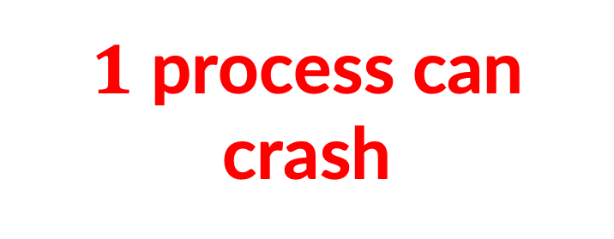
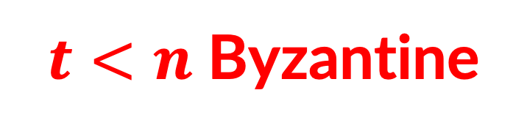
System
$$P_{1}$$
$$P_{8}$$
$$P_{2}$$
$n$ processes
$$P_{7}$$
$1$ process can crash
$$P_{3}$$
$$P_{6}$$
$$P_{4}$$
$$P_{5}$$
Notes:
Out of which t processes can be Byzantine and behave arbitrarily.
A Byzantine process is said to be faulty, whereas a non-Byzantine process is correct.

Slide 5


Interface of Consensus
Propose
Operation
Decide
Callback
Notes:
In consensus, each process is allowed to propose and decide.

Slide 6
Properties of Consensus
Termination: All correct processes decide.
Integrity: No process decides more than once.
Agreement: No two correct processes decide different values.
Validity: A decided value is proposed.
Notes:
In consensus, each process is allowed to propose and decide.

Slide 7
Asynchronous Model
Arbitrary (but finite) message delays
Notes:
To make the problem useful and preclude the aforementioned trivial solutions, we have the third property of consensus: validity.
In a nutshell, validity requires that only admissible values can be decided.
So, with the validity property, the algorithm which simply decides a default value (which we saw before) does not work as 0 might not be admissible in every single case.

Slide 8
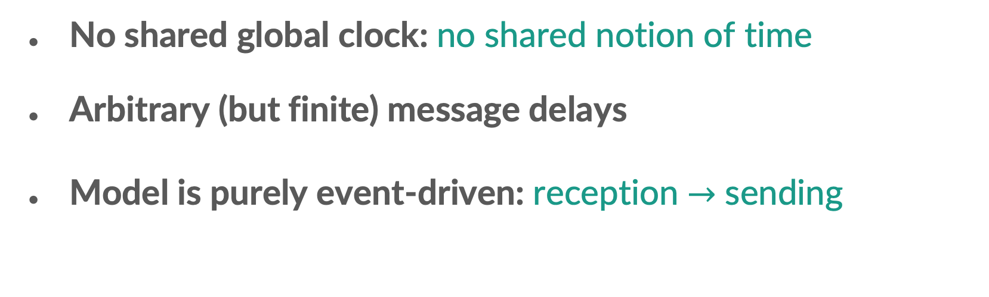
Asynchronous Model (Informal)
No shared global clock: no shared notion of time
Arbitrary (but finite) message delays
Model is purely event-driven: reception $→$ sending
Notes:
In consensus, each process is allowed to propose and decide.

Slide 9
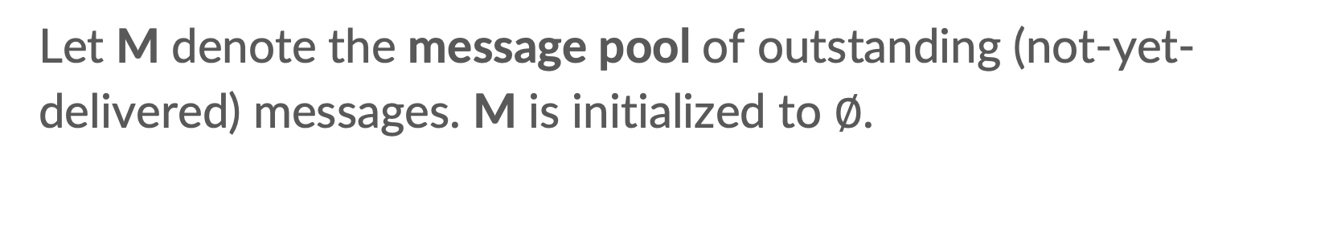
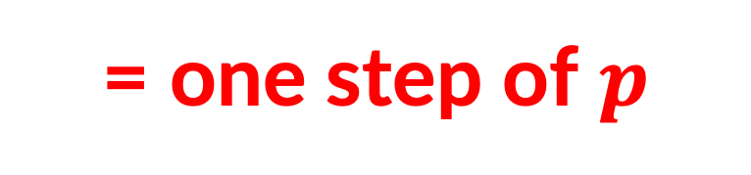
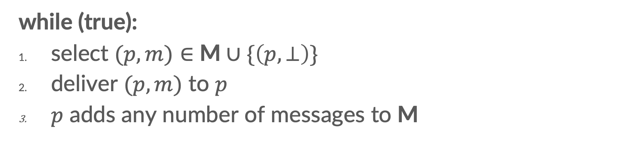
Asynchronous Model (Formal)
Let M denote the message pool of outstanding (not-yet-delivered) messages. M is initialized to $∅$.
the adversary controls
while (true):
select $(p,m)∈$ M$∪\{\left(p,⊥\right)\}$
deliver $(p,m)$ to $p$
$p$ adds any number of messages to M
= one step of $p$
Notes:
In consensus, each process is allowed to propose and decide.

Slide 10
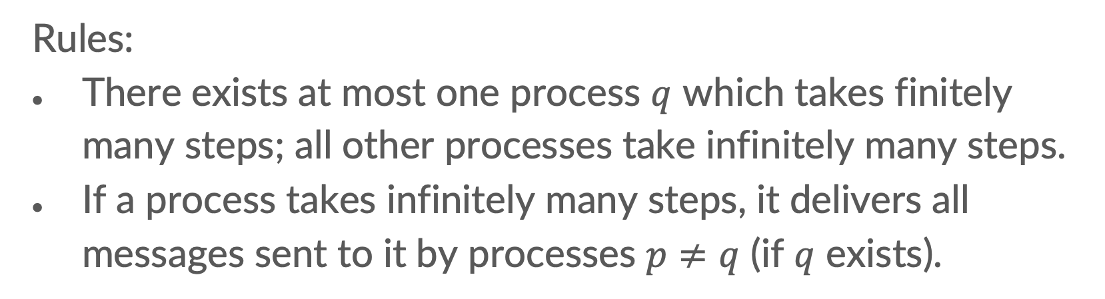
Asynchronous Model (Formal)
while (true):
select $(p,m)∈$ M$∪\{\left(p,⊥\right)\}$
deliver $(p,m)$ to $p$
$p$ adds any number of messages to M
Rules:
There exists at most one process $q$ which takes finitely many steps; all other processes take infinitely many steps.
If a process takes infinitely many steps, it delivers all messages sent to it by processes $p≠q$ (if $q$ exists).
Notes:
In consensus, each process is allowed to propose and decide.

Slide 11

FLP Impossibility Result
For every $n≥2$, even with $f=1$, no deterministic protocol for binary consensus exists.
Notes:
To make the problem useful and preclude the aforementioned trivial solutions, we have the third property of consensus: validity.
In a nutshell, validity requires that only admissible values can be decided.
So, with the validity property, the algorithm which simply decides a default value (which we saw before) does not work as 0 might not be admissible in every single case.

Slide 12

Proof by Contradiction
Consensus protocol $Π$ exists.
Notes:
In consensus, each process is allowed to propose and decide.

Slide 13
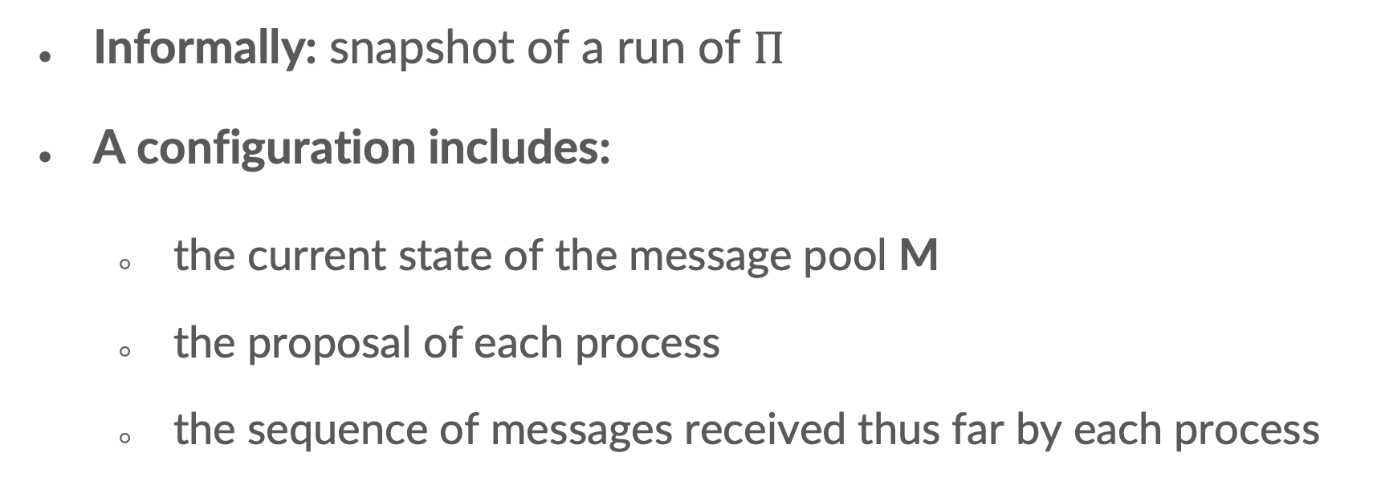
Configurations
Informally: snapshot of a run of $Π$
A configuration includes:
  the current state of the message pool M
  the proposal of each process
  the sequence of messages received thus far by each process
Notes:
In consensus, each process is allowed to propose and decide.

Slide 14











Runs of $Π$
Walk through a big (possibly infinite) directed graph, with vertices corresponding to configurations and edges corresponding to message deliveries.
$$C_{1}$$
$$(p_{3},m_{3})$$
…
$$(p_{1},m_{1})$$
$$C_{3}$$
…
$$C_{0}$$
$$C_{5}$$
$$(p_{2},m_{2})$$
$$(p_{5},m_{5})$$
$$(p_{4},m_{4})$$
$$C_{2}$$
$$C_{4}$$
Notes:
How does the configuration change?

Slide 15
Types of Configurations
0-valent: iff all possible sequences of message deliveries lead to the all-zero outcome
1-valent: iff all possible sequences of message deliveries lead to the all-one outcome
bivalent: if it is neither 0- nor 1-valent configuration
Notes:
These configurations are defined with respect to a protocol which solves consensus.
In our case, it is Pi.

Slide 16
High-Level Proof Plan
Infinite path of bivalent configurations.
Notes:
We start with an initial bivalent configuration

Slide 17
Lemma 1
There exists a bivalent initial configuration.
Notes:
To make the problem useful and preclude the aforementioned trivial solutions, we have the third property of consensus: validity.
In a nutshell, validity requires that only admissible values can be decided.
So, with the validity property, the algorithm which simply decides a default value (which we saw before) does not work as 0 might not be admissible in every single case.

Slide 18

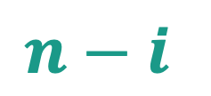

Lemma 1: Proof
$$X_{i}=111…11000…00$$
$$i$$
$$n−i$$
Notes:
In consensus, each process is allowed to propose and decide.

Slide 19




Lemma 1: Proof
0-valent
$$X_{0}=000…00$$
…
$$X_{1}=100…00$$
$$X_{n−1}=111…10$$
1-valent
$$X_{n}=111…11$$
Notes:
In consensus, each process is allowed to propose and decide.

Slide 20



Lemma 1: Proof
0-valent
$$X_{j}=11…1100…00$$
1-valent
$$X_{j+1}=11…1110…00$$
$$p_{j+1}$$
Notes:
In consensus, each process is allowed to propose and decide.

Slide 21
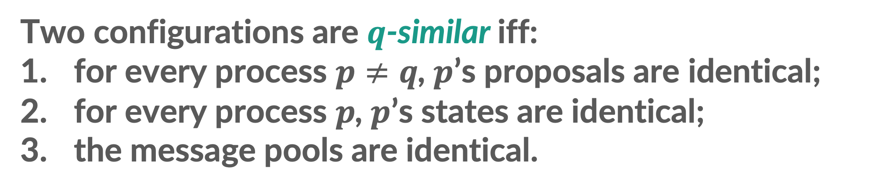
Lemma 1: Proof
Two configurations are $q$-similar iff:
for every process $p≠q$, $p$’s proposals are identical;
for every process $p$, $p$’s states are identical;
the message pools are identical.
Notes:
In consensus, each process is allowed to propose and decide.

Slide 22


















Lemma 1: Proof
Run of $Π$ where $p_{j+1}$ crashes at the start (takes no steps):
$$(p_{1},m_{1})$$
$$(p_{2},m_{2})$$
$$(p_{3},m_{3})$$
$$(p_{4},m_{4})$$
$$X_{j}$$
$$C_{1}$$
$$C_{2}$$
$$C_{3}$$
$$C_{4}$$
$$(p_{5},m_{5})$$
$$(p_{x},m_{x})$$
…
$$(p_{8},m_{8})$$
$$(p_{7},m_{7})$$
$$(p_{6},m_{6})$$
$$C_{x}$$
$$C_{7}$$
$$C_{6}$$
$$C_{5}$$
all-zero
state
Notes:
In consensus, each process is allowed to propose and decide.

Slide 23
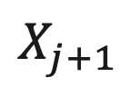
Lemma 1: Proof
Run of $Π$ where $p_{j+1}$ crashes at the start (takes no steps):
$$X_{j+1}$$
Notes:
In consensus, each process is allowed to propose and decide.

Slide 24
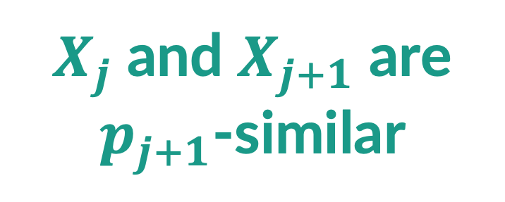
Lemma 1: Proof
Run of $Π$ where $p_{j+1}$ crashes at the start (takes no steps):
$$X_{j+1}$$
$X_{j}$ and $X_{j+1}$ are $p_{j+1}$-similar
Notes:
In consensus, each process is allowed to propose and decide.

Slide 25

Lemma 1: Proof
Run of $Π$ where $p_{j+1}$ crashes at the start (takes no steps):
$$(p_{1},m_{1})$$
$$X_{j+1}$$
$$C_{1}′$$
Notes:
In consensus, each process is allowed to propose and decide.

Slide 26
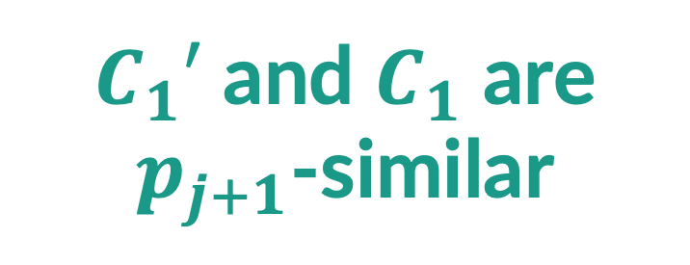
Lemma 1: Proof
Run of $Π$ where $p_{j+1}$ crashes at the start (takes no steps):
$$(p_{1},m_{1})$$
$$X_{j+1}$$
$$C_{1}′$$
$C_{1}′$ and $C_{1}$ are $p_{j+1}$-similar
Notes:
In consensus, each process is allowed to propose and decide.

Slide 27

Lemma 1: Proof
Run of $Π$ where $p_{j+1}$ crashes at the start (takes no steps):
$$(p_{1},m_{1})$$
$$(p_{2},m_{2})$$
$$X_{j+1}$$
$$C_{1}′$$
$$C_{2}′$$
Notes:
In consensus, each process is allowed to propose and decide.

Slide 28

Lemma 1: Proof
Run of $Π$ where $p_{j+1}$ crashes at the start (takes no steps):
$$(p_{1},m_{1})$$
$$(p_{2},m_{2})$$
$$X_{j+1}$$
$$C_{1}′$$
$$C_{2}′$$
$C_{2}′$ and $C_{2}$ are $p_{j+1}$-similar
Notes:
In consensus, each process is allowed to propose and decide.

Slide 29






Lemma 1: Proof
Run of $Π$ where $p_{j+1}$ crashes at the start (takes no steps):
$$(p_{1},m_{1})$$
$$(p_{2},m_{2})$$
$$(p_{3},m_{3})$$
$$(p_{4},m_{4})$$
$$X_{j+1}$$
$$C_{1}′$$
$$C_{2}′$$
$$C_{3}′$$
$$C_{4}′$$
$$(p_{5},m_{5})$$
$$(p_{x},m_{x})$$
…
$$(p_{8},m_{8})$$
$$(p_{7},m_{7})$$
$$(p_{6},m_{6})$$
$$C_{x}′$$
$$C_{7}′$$
$$C_{6}′$$
$$C_{5}′$$
Notes:
In consensus, each process is allowed to propose and decide.

Slide 30
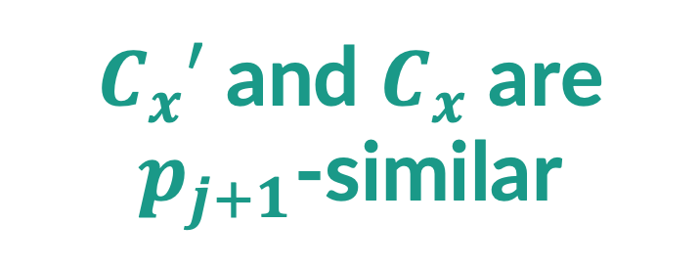
Lemma 1: Proof
Run of $Π$ where $p_{j+1}$ crashes at the start (takes no steps):
$$(p_{1},m_{1})$$
$$(p_{2},m_{2})$$
$$(p_{3},m_{3})$$
$$(p_{4},m_{4})$$
$$X_{j+1}$$
$$C_{1}′$$
$$C_{2}′$$
$$C_{3}′$$
$$C_{4}′$$
$C_{x}′$ and $C_{x}$ are $p_{j+1}$-similar
$$(p_{5},m_{5})$$
$$(p_{x},m_{x})$$
…
$$(p_{8},m_{8})$$
$$(p_{7},m_{7})$$
$$(p_{6},m_{6})$$
$$C_{x}′$$
$$C_{7}′$$
$$C_{6}′$$
$$C_{5}′$$
Notes:
In consensus, each process is allowed to propose and decide.

Slide 31

Lemma 1: Proof
Run of $Π$ where $p_{j+1}$ crashes at the start (takes no steps):
$$(p_{1},m_{1})$$
$$(p_{2},m_{2})$$
$$(p_{3},m_{3})$$
$$(p_{4},m_{4})$$
$$X_{j+1}$$
$$C_{1}′$$
$$C_{2}′$$
$$C_{3}′$$
$$C_{4}′$$
Contradiction: $X_{j+1}$ is 1-valent!
$C_{x}′$ and $C_{x}$ are $p_{j+1}$-similar
$$(p_{5},m_{5})$$
$$(p_{x},m_{x})$$
…
$$(p_{8},m_{8})$$
$$(p_{7},m_{7})$$
$$(p_{6},m_{6})$$
$$C_{x}′$$
$$C_{7}′$$
$$C_{6}′$$
$$C_{5}′$$
all-zero
state
Notes:
In consensus, each process is allowed to propose and decide.

Slide 32

Lemma 2
Let $C_{i}$ denote a bivalent configuration and $(p,m)$ a message in $C_{i}$’s message pool.
Then, there exists a sequence of message deliveries such that:
the last step of the sequence is the delivery of $\left(p,m\right);$
(2) the end of the sequence is a bivalent configuration $C_{i+1}$.
Notes:
To make the problem useful and preclude the aforementioned trivial solutions, we have the third property of consensus: validity.
In a nutshell, validity requires that only admissible values can be decided.
So, with the validity property, the algorithm which simply decides a default value (which we saw before) does not work as 0 might not be admissible in every single case.

Slide 33

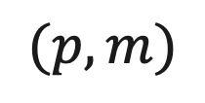

Lemma 2: Illustration
$$(p,m)$$
$$C_{i}$$
$$C_{i+1}$$
bivalent
bivalent
Notes:
In consensus, each process is allowed to propose and decide.

Slide 34
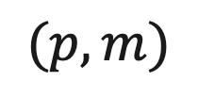


Lemma 2: Proof
Case 1: Delivering $(p,m)$ leads to a bivalent configuration
$$(p,m)$$
$$C_{i}$$
$$C_{i+1}$$
bivalent
bivalent
Notes:
In consensus, each process is allowed to propose and decide.

Slide 35
Lemma 2: Proof
Case 2: Delivering $(p,m)$ leads to a 0-valent configuration
$$(p,m)$$
$$C_{i}$$
$$C_{i+1}$$
0-valent
bivalent
Notes:
]

Slide 36
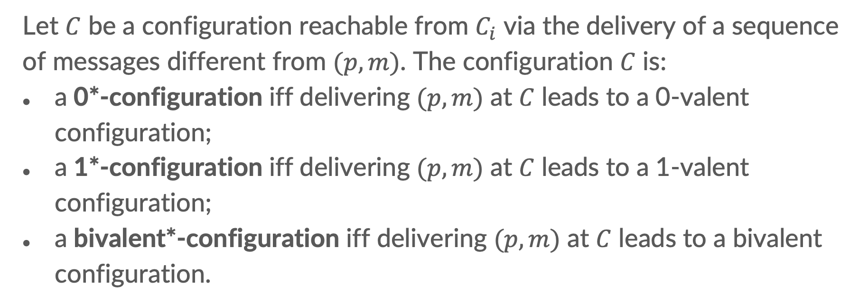
Lemma 2: Proof
Case 2: Delivering $(p,m)$ leads to a 0-valent configuration
Let $C$ be a configuration reachable from $C_{i}$ via the delivery of a sequence of messages different from $(p,m)$. The configuration $C$ is:
a 0*-configuration iff delivering $(p,m)$ at $C$ leads to a 0-valent configuration;
a 1*-configuration iff delivering $(p,m)$ at $C$ leads to a 1-valent configuration;
a bivalent*-configuration iff delivering $(p,m)$ at $C$ leads to a bivalent configuration.
Notes:
This definition holds with respect to Ci and (p, m) message.

Slide 37
Lemma 2: Proof (Case 2)
New goal: there exists a bivalent*-configuration
Observation: $C_{i}$ is a 0*-configuration.
Notes:
Note that Ci cannot be bivalent* as delivering

Slide 38

Lemma 2: Proof (Case 2)
There exists a non-0*-configuration.
(Otherwise, $C_{i}$ is 0-valent.)
Notes:
]

Slide 39

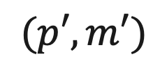

Lemma 2: Proof (Case 2)
$$(p′,m′)$$
$$C_{i}$$
$$X$$
$$Y$$
0*
0*
0*
0*
0*
non-0*
Notes:
]

Slide 40
Lemma 2: Proof (Case 2)
$$(p′,m′)$$
$$C_{i}$$
$$X$$
$$Y$$
0*
0*
0*
0*
0*
1*
Notes:
]

Slide 41


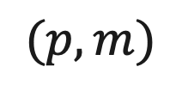
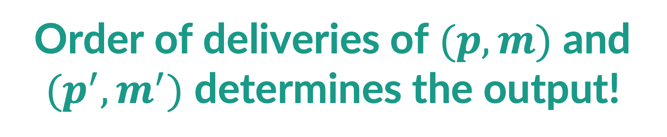

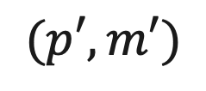




Lemma 2: Proof (Case 2)
$$(p′,m′)$$
$$(p,m)$$
$$(p′,m′)$$
$$(p,m)$$
x
x
x
$$V$$
$$W$$
$$X$$
$$Y$$
$$Z$$
0-valent
0-valent
0*
1*
1-valent
Order of deliveries of $(p,m)$ and $(p^{′},m^{′})$ determines the output!
Notes:
]

Slide 42


Lemma 2: Proof (Case 2)
Scenario 1: $p≠p′$.
$$(p′,m′)$$
$$(p,m)$$
$$(p′,m′)$$
$$(p,m)$$
x
x
x
Contradiction: $Z=V$ cannot be 0- and 1-valent!
$$V$$
$$W$$
$$X$$
$$Y$$
$$Z$$
0-valent
0-valent
0*
1*
1-valent
$$Z=V!$$
Notes:
]

Slide 43

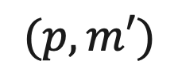

Lemma 2: Proof (Case 2)
Scenario 2: $p=p′$.
$$(p,m′)$$
$$(p,m)$$
$$(p,m′)$$
$$(p,m)$$
x
x
x
$$V$$
$$W$$
$$X$$
$$Y$$
$$Z$$
0-valent
0-valent
0*
1*
1-valent
$Z$ and $V$ are identical except in $p.$
Notes:
]

Slide 44




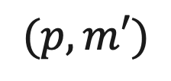

Lemma 1: Proof
We crash $p$ immediately after $Z$ (takes no steps after $Z$).
We never deliver $p$’s pending messages.
$$(p,m′)$$
$$(p,m)$$
…
x
$$X$$
$$Y$$
$$Z$$
all-one
state
0*
1*
1-valent
We can apply the same continuation from $Z$ to $V.$
Notes:
In consensus, each process is allowed to propose and decide.

Slide 45
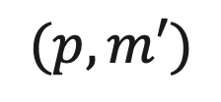




Lemma 1: Proof
We crash $p$ immediately after $Z$ (takes no steps after $Z$).
We never deliver $p$’s pending messages.
$$(p,m)$$
$$(p,m′)$$
…
Contradiction: $V$ is 0-valent!
x
$$X$$
$$W$$
$$V$$
all-one
state
0*
0-valent
0-valent
We can apply the same continuation from $Z$ to $V.$
Notes:
In consensus, each process is allowed to propose and decide.

Slide 46
Lemma 1 + Lemma 2
Notes:
To make the problem useful and preclude the aforementioned trivial solutions, we have the third property of consensus: validity.
In a nutshell, validity requires that only admissible values can be decided.
So, with the validity property, the algorithm which simply decides a default value (which we saw before) does not work as 0 might not be admissible in every single case.

Slide 47
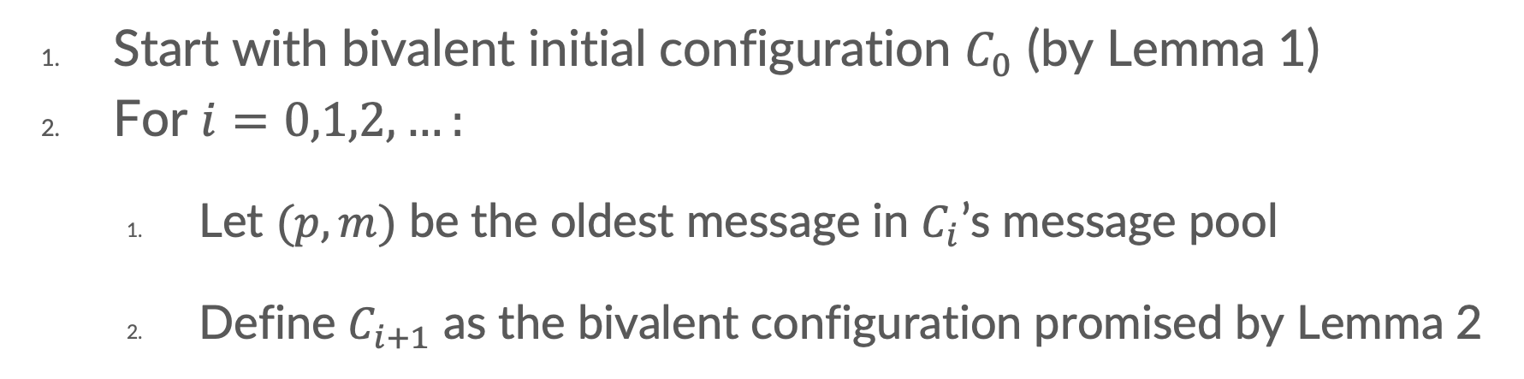
Lemma 1 + Lemma 2
Start with bivalent initial configuration $C_{0}$ (by Lemma 1)
For $i=0,1,2,…:$
  Let $(p,m)$ be the oldest message in $C_{i}$’s message pool
  Define $C_{i+1}$ as the bivalent configuration promised by Lemma 2
Notes:
In consensus, each process is allowed to propose and decide.

Slide 48
Takeaway
FLP impossibility result proves impossibility of asynchronous consensus even if only 1 process can crash. The proof shows existence of an infinite non-terminating execution.
Notes:
To make the problem useful and preclude the aforementioned trivial solutions, we have the third property of consensus: validity.
In a nutshell, validity requires that only admissible values can be decided.
So, with the validity property, the algorithm which simply decides a default value (which we saw before) does not work as 0 might not be admissible in every single case.

